Slide 1







Lecture 15:
Express Routing & REST APIs
Course - Web Development - III
-By
Pratik Raj Verma
welcome@krmangalam.edu.in
Sohna Road,Gurugram,Haryana 122103

Slide 2

| Table of Contents
Routing
REST APIs
Modular Routing
References.
The End.

Slide 3

|
In this lecture, we will learn how to call controller functions through different routes and understand how Express forwards requests to the appropriate controller.
By the end of this session, you will be able to create routes, connect them with controllers, and build a structured REST API using the MVC pattern.

Slide 4

|
Have you ever wondered:
How does Instagram know which page to open? How does Amazon show products? How does YouTube open a specific video?
When a user sends a request, how does the server know which function should run?

Slide 5
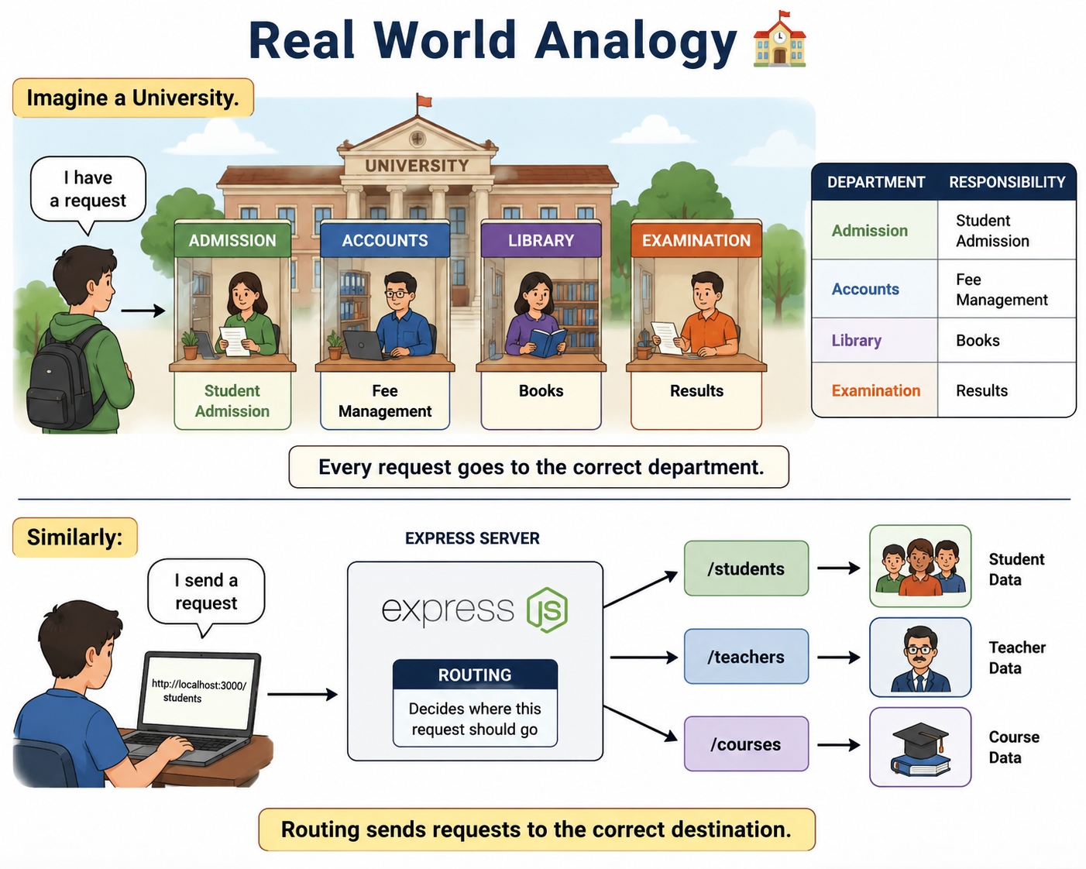
|
Have you ever wondered:
How does Instagram know which page to open? How does Amazon show products? How does YouTube open a specific video?
When a user sends a request, how does the server know which function should run?
The answer is: Routing

Slide 6
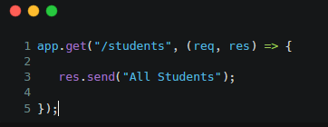
| Routing?
Routing is the process of defining how an application responds to client requests for specific URLs and HTTP methods.
Routing decides:
Which URL was requested
Which controller should run
What response should be returned
First Route Example :
Request:
GET /students
Response:
All Students

Slide 7
| Routing?
What is an API Endpoint?
An API Endpoint is a URL where a client sends requests.
Examples:
/students
/teachers
/courses
/users
Each endpoint performs a specific task.

Slide 8
| Routing?
What is a REST API?
A REST API (Representational State Transfer Application Programming Interface) is an API that follows REST architectural principles and enables communication between a client and a server using HTTP methods such as GET, POST, PUT, and DELETE to perform operations on resources.
REST APIs use:
Resources
HTTP Methods
Meaningful URLs
REST APIs should:
Use resources as URLs
Use HTTP methods properly
Follow naming conventions
Be easy to understand
Be easy to maintain

Slide 9
| Routing?
Resource Based Routing
Good:
/students
/teachers
/products
Bad:
/getStudents
/createStudent
/deleteStudent
Resource should represent data, not action. REST focuses on nouns (resources) rather than verbs (actions).

Slide 10
| Routing?
Understanding HTTP Methods
CRUD vs HTTP Methods
HTTP Methods tell the server what action should be performed.
This mapping is used in almost every REST API.
Method | Purpose
GET | Retrieve Data
POST | Create Data
PUT | Update Data
DELETE | Remove Data
CRUD Operation | HTTP Method
Create | POST
Read | GET
Update | PUT
Delete | DELETE

Slide 11
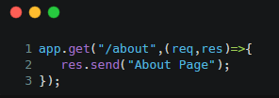
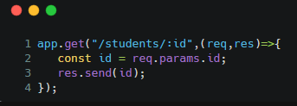
| Routing?
Static Routes : Static routes have fixed URLs.
Dynamic Routes :Dynamic routes contain variable values.
Examples:
/about
Examples:
/students/1
/students/10
/students/100

Slide 12
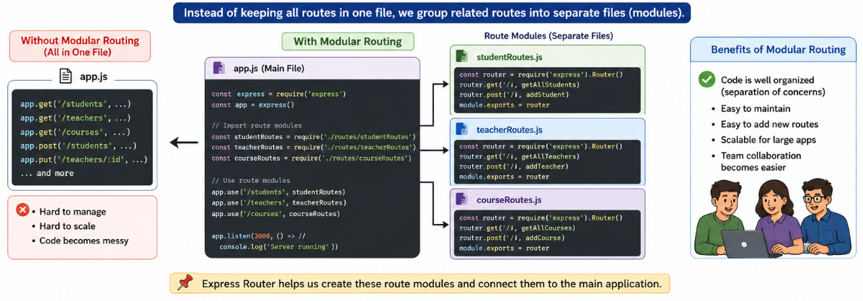
| Modular Routing
Modular Routing is a technique in Express.js where application routes are organized into separate files or modules based on their functionality.
project/
│
├── routes/
│ ├── studentRoutes.js
│ ├── teacherRoutes.js
│ └── courseRoutes.js
│
├── controllers/
├── models/
└── server.js

Slide 13
|
In the last lecture, we learned how to define and organize application logic inside Controllers following the MVC architecture.
Now that our controllers are ready, the next step is to connect them with Routes so that they can handle incoming client requests

Slide 14
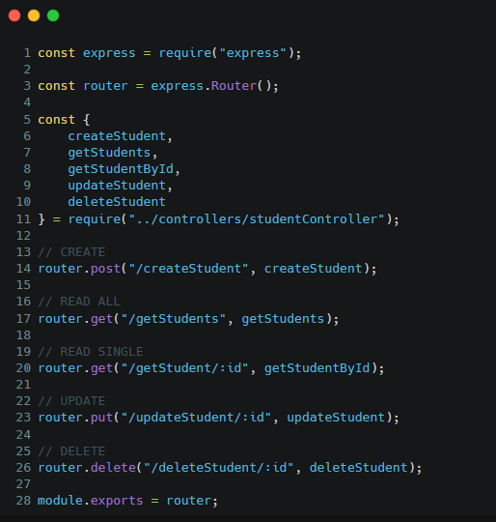
| Routing?

Slide 15

| Check Your Understanding
Question : What is the primary purpose of Routing in Express.js?
Options : A. Store data in database B. Define how the server responds to specific URLs and HTTP methods C. Create frontend pages D. Install Express.js
Answer : B. Define how the server responds to specific URLs and HTTP methods
Explanation:
Routing decides:
Which URL was requested
Which controller should execute
What response should be returned

Slide 16
| Check Your Understanding
Question : Which HTTP Method is used to update existing data in a REST API?
Options : A. GET
B. POST
C. PUT
D. DELETE
Answer : C. PUT
Explanation:
PUT is used to update existing records.

Slide 17
| Check Your Understanding
Question : What is the difference between Static Routes and Dynamic Routes?
Options : A. Static routes use variables, Dynamic routes do not
B. Static routes have fixed URLs, Dynamic routes contain variable values
C. Both are exactly the same
D. Dynamic routes are used only with POST requests
Answer : B. Static routes have fixed URLs, Dynamic routes contain variable values
Explanation:
A Static Route is a route with a fixed URL that remains the same for every request. A Dynamic Route is a route that contains variable values inside the URL.

Slide 18
| References
MDN Web Docs : Comprehensive and official documentation for Express Js 🔗https://developer.mozilla.org/en-US/docs/Learn_web_development/Extensions/Server-side/Express_Nodejs
W3Schools : Beginner-friendly express tutorials with examples and interactive editors. 🔗https://www.w3schools.com/nodejs/nodejs_express.asp
Express Official- A comprehensive tutorial-style website that covers core Express JS concepts in depth.
🔗https://expressjs.com/en/

Slide 19
Thanks
For
Watching
Course - Web Development - III
welcome@krmangalam.edu.in
Sohna Road,Gurugram,Haryana 122103

